Slide 1
Lesson 1
E115 – Programming and Data analysis

Slide 2
Lesson objectives
At the end of the lesson, you should be able to:
Create a VBA procedure by
Recording and playing back a macro
Manually typing code
Manipulate the following properties of a cell via code:
Value
Font
Color
Make use of the “If – Else” conditional statement in your macro.
Make use of comparison operators <,>,<=,>= and <> in your “If – Else” statements
Make use of the “And” and the “Or” operators in your “If… Else…” conditional statements

Slide 3
What is an Excel procedure?
A procedure is computer programming code that is stored inside an Excel file to automate tasks and saves you time and effort.
In Excel, a procedure is also known as a “macro”.
E.g. Your cumulative GPA (cGPA) changes every semester. You can create a procedure to automatically calculate your cGPA.
Demo

Slide 4
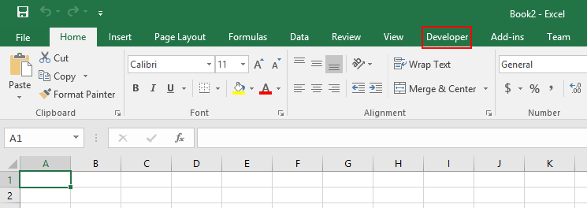
Do it with me
Open up your Excel and look for “Developer” tab in the ribbon:

Slide 5
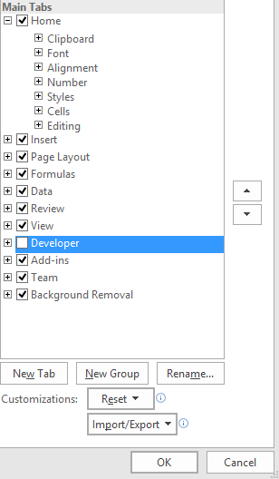
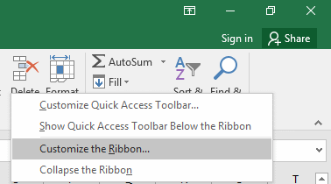
How to activate Excel Developer
If you cannot find Developer tab…
a) Right-click and select “Customize the Ribbon”:
b) Check the “Developer” box:

Slide 6
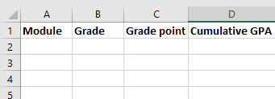
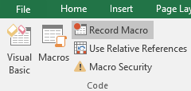
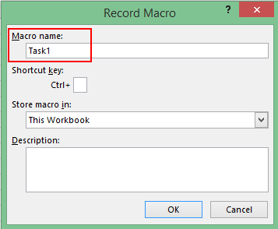
Do it with me
We will create a macro that can automatically create the following headings for us in Excel:
Step 1: Click on “Record Macro”.
Step 2: Give the macro a name.

Slide 7

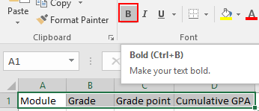

Do it with me
Step 3: Type the following words into Row 1 Columns A to D.
Step 4: Bold the words that you have just typed.
Step 5: Stop recording.

Slide 8
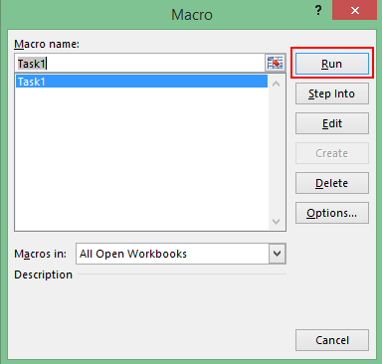
Do it with me
Finally, delete everything that you have typed and test your macro.

Slide 9
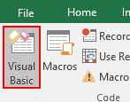
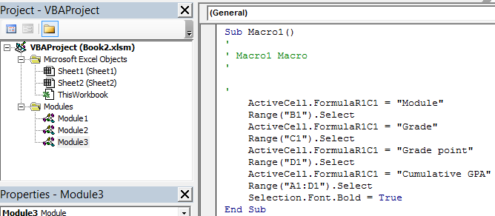
Behind the scenes
Code has been automatically generated for you by the recording process.
To view, double-click on “Module1”.
Notes:
Each student’s code might differ depending on the steps you took during the recording process.

Slide 10

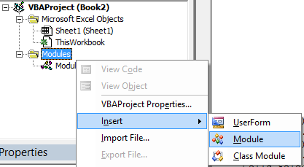
Do it with me
We will now create the same table by writing code.
Step 1: Create a new Excel file with a blank sheet.
Step 2: Open the Visual Basic editor window (Alt + F11). Right-click on “VBAProject” and insert a new module.

Slide 11
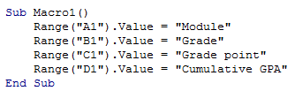
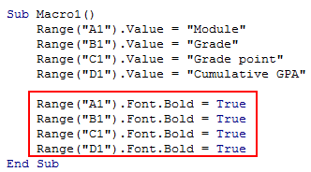
Do it with me
Step 3: Type the following into the code window and run it. Do you see your headers appearing?
Step 4: To bold the text, add the following code into your macro.

Slide 12
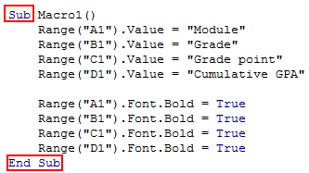
Explanation of code – Subroutine
“Sub” stands for subroutine. Think of it as a container to keep your codes. All code must be written in between the keywords “Sub” and “End Sub”.
There can be more than one subroutine in your Excel VBA module. Therefore each subroutine must have a name. The name of the above subroutine is “Macro1”.

Slide 13
Explanation of code
Object
Property
Value
Translation: Set the Value of Cell “A1” to be “Module”.
i.e. write the word “Module” into Cell A1.
Translation: Make the Font of Cell “A1” Bold.

Slide 14
Exercise
Try out the following codes to see what each of them does:
Range("A1").Font.Color = vbRed
Range("B1").Font.FontStyle = "Italic”
Range(“A1:D1”).Font.FontStyle = “Bold”
Range("C1").Borders.LineStyle = xlDouble

Slide 15

Decision making
We will now write our own code that can automatically convert your module grade into a grade point.
Step 1: Create an Excel table like the example above. You may replace the module name to any other module where you have gotten a “B” grade.
Step 2: Right-click on “Modules” and insert a new module:

Slide 16

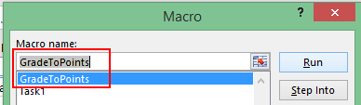

If… Then…
Step 3: Type the following code into your new module
Step 4: Test your code: You should see the number “3” appearing beside the grade “B”.

Slide 17

Explanation of code
Translation of the above code to English:
If the value in Cell C2 is equal to “B”, Then Set the value of Cell D2 to be 3.
The End.

Slide 18
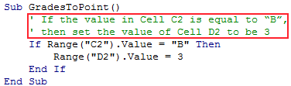
Adding comments to your code
It is a good habit to add comments to your own code that describes what the code is doing.
Comments allow people who are reading your code to understand what you are trying to do.
Comments appear in green and are ignored by Visual Basic.
Comments

Slide 19
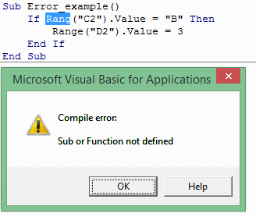
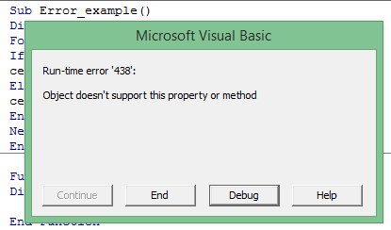
Some types of errors you will encounter
Learn to troubleshoot your own errors.
Types of errors:
Compile errors (most likely due to typo error)
Run-time errors

Slide 20
Exercise 2
Translate the following instructions into proper code:
If the value in Cell C2 is equal to “C”, Then
Set the value of Cell D2 to be 2.
The End.
Answer:
If Range(“C2”).Value = “C” Then
Range(“D2”).Value = 2
End If

Slide 21

Exercise 3
What if you scored a “C” for the module instead of a “B”?
Modify your macro so that it can generate the grade point for modules with either a “B” or a “C” grade.
Answer:
Sub GradesToPoints()
If Range(“C2”).Value = “B” Then
Range(“D2”).Value = 3
End If
If Range(“C2”).Value = “C” Then
Range(“D2”).Value = 2
End If
End Sub

Slide 22
If… ElseIf… End If
Example A and Example B below both achieve the same result. Which one do you prefer?
Example A:
Sub GradesToPoints()
If Range(“C2”).Value = “B” Then
Range(“D2”).Value = 3
End If
If Range(“C2”).Value = “C” Then
Range(“D2”).Value = 2
End If
End Sub
Example B:
Sub GradesToPoints()
If Range(“C2”).Value = “B” Then
Range(“D2”).Value = 3
ElseIf Range(“C2”).Value = “C” Then
Range(“D2”).Value = 2
End If
End Sub

Slide 23

Example: “If… ElseIf… Else… End If”
If Range(“A2”).Value = “Scissors” Then
Range(“B2”). Value = “Stone”
ElseIf Range(“A2”).Value = “Paper” Then
Range(“B2”). Value = “Scissors”
Else
Range(“B2”).Value = “Paper”
End If
Translation of the above code to English:
If the value in Cell A2 is equal to “Scissors”,
Then set the value of Cell B2 to be “Stone”.
Otherwise If the value in Cell A2 is equal to “Paper”,
Then set the value of Cell B2 to be “Scissors”.
Otherwise
Set the value of Cell B2 to be “Paper”.
The End

Slide 24


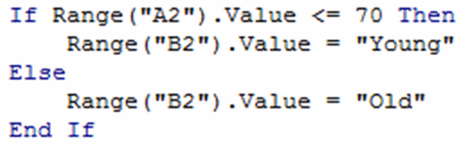
Comparison operators: >, <, >=, <=, <>
Question: What word will appear in Cell B2 when the following code is run?
Answer: Old
Question: What word will appear in Cell B2 when the following code is run?
Answer: Young

Slide 25
Relational operators: =, >, <, >=, <=, <>
Equal: =
Greater than: >
Greater than or equal to: >=
Less than: <
Less than or equal to: <=
Not equal: <>

Slide 26

Exercise
What word will appear in Cell B2 when the following code is run?
Answer: Old
<> means “Not Equal”

Slide 27

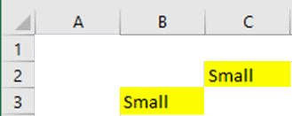
“AND” Operator
E.g. There are 9 cells as shown below.
Select the cells that are yellow AND have the word “Small”.
Which cells will be selected?
Answer:

Slide 28
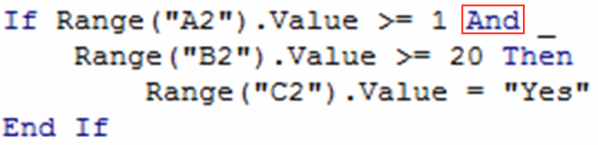

Example of “AND” operator usage

Slide 29

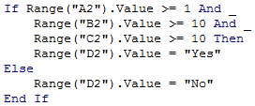
Exercise
Create the following table in Excel and write VBA code to fill in the “Graduate?” column with either a “Yes” or a “No”.
Answer

Slide 30

“OR” Operator

